Slide 1

Design Review 1
Group 7
Samuel Prasse
Kaitlyn Grubb
Tyler Pehringer
Joshus Tenakhongva

Slide 2



Introduction - Team GeoLearn
Samuel - Team Lead
Kaitlyn - Architect
Tyler - Editor, Release Manager
Joshus - Editor, Recorder
Andrew “Roo” Abraham
Fabio Santos
Dr. Chris Doughty
Notes:
SP

Slide 3

Problem Statement
Struggles of teaching about climate info.
  Hard to simplify.
  Incorrect information.
  Time consuming.
Kids struggle to learn.
  Hard to understand.
  May seem uninteresting.
There is no technology out there that can help with this.
Notes:
T Fabio - teacher workflow of manual create slides

Slide 4


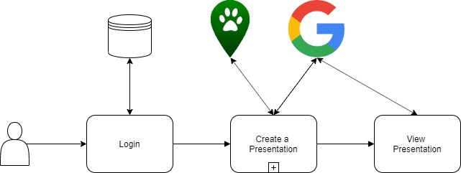
Solution Overview
Notes:
K

Slide 5



Solution Overview
Problems
Gathering Info
Different Info
Storing User Info
Teacher Access
Development
Challenges
Google Slides and Earth Engine Interaction
Ecolocation Interaction
Database Storage
Accessibility
Development/Debugging Environment
Solutions
Automate slide creation with API
Past Capstone
SQL
Web Application
PyCharm
Notes:
K API slides instead of Python

Slide 6


How We Got Our Requirements
Weekly meetings
Ecolocation documentation
Notes:
T

Slide 7


List of Key Requirements
Generate slides based on location
Develop interactive pages to accompany the slides
Slides must grab info automatically
Slides must save to users Google Drive
Slides must format info properly
Notes:
T

Slide 8
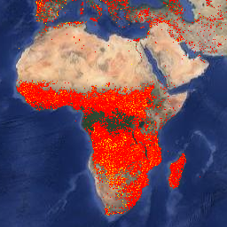
Top-Level Functional Requirements
Generate slides based on location
  Biodiversity
  Land Use / Change
Develop interactive pages to accompany the slides
  Contain same tools we use to build presentations
FIRMS: Fire Information for Resource Management System
Notes:
SP

Slide 9
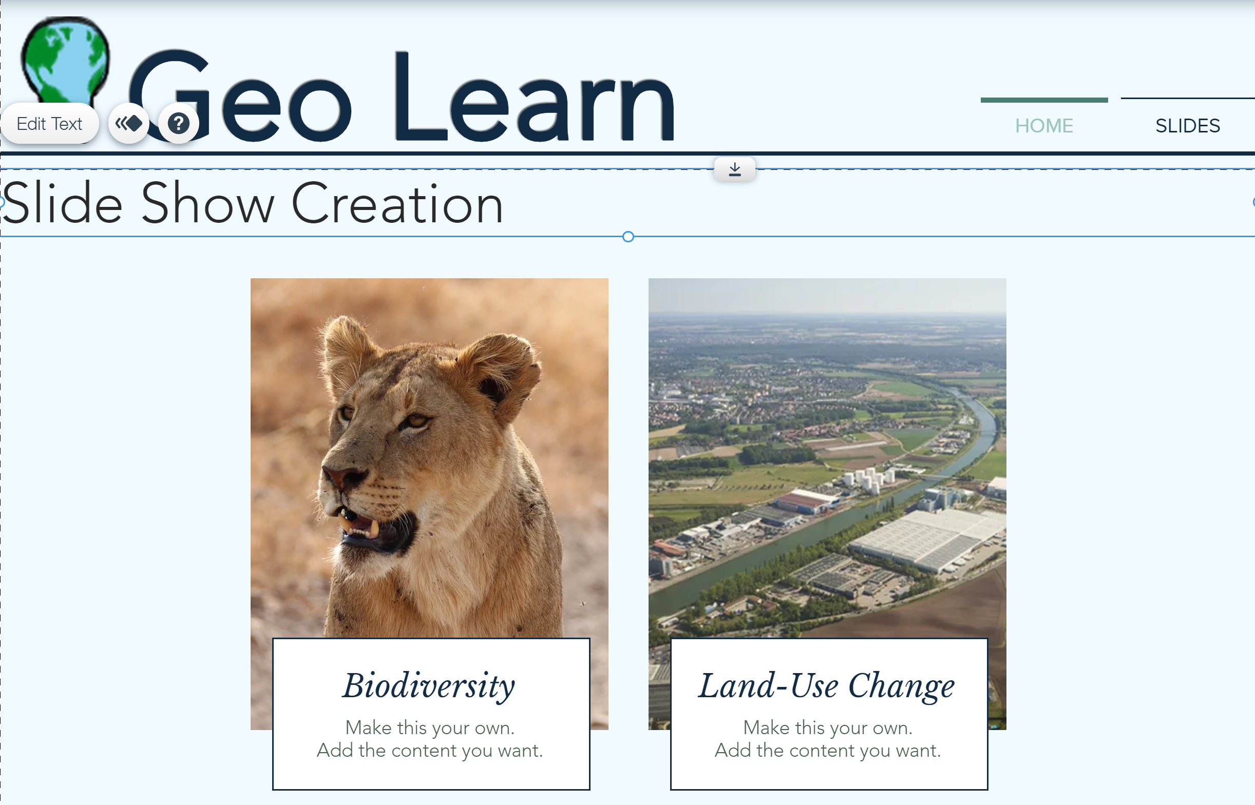
Performance Requirements
Slide generation time
  Slides must be generated in a reasonable time period
User interface
  Easy to navigate
Accessibility
  Web app must be available from home
Notes:
SP Fabio - Add requirements to meet - Add number of users

Slide 10


Environmental Constraints
API constraints
  Have to use JS and Python
Google Emails
  Google Security
Implementation of Ecolocation
  SQL DB
Open Ended
  Sponsor allows us to make a lot of our own decisions
Notes:
SP

Slide 11
Breaking Down Key Requirement: Generate a Slideshow Based on Location
Get info - location, subject, and age
Get slide data based on location, subject, and age
Put information into a slide
Deliver slide to user
Notes:
Kaitlyn

Slide 12
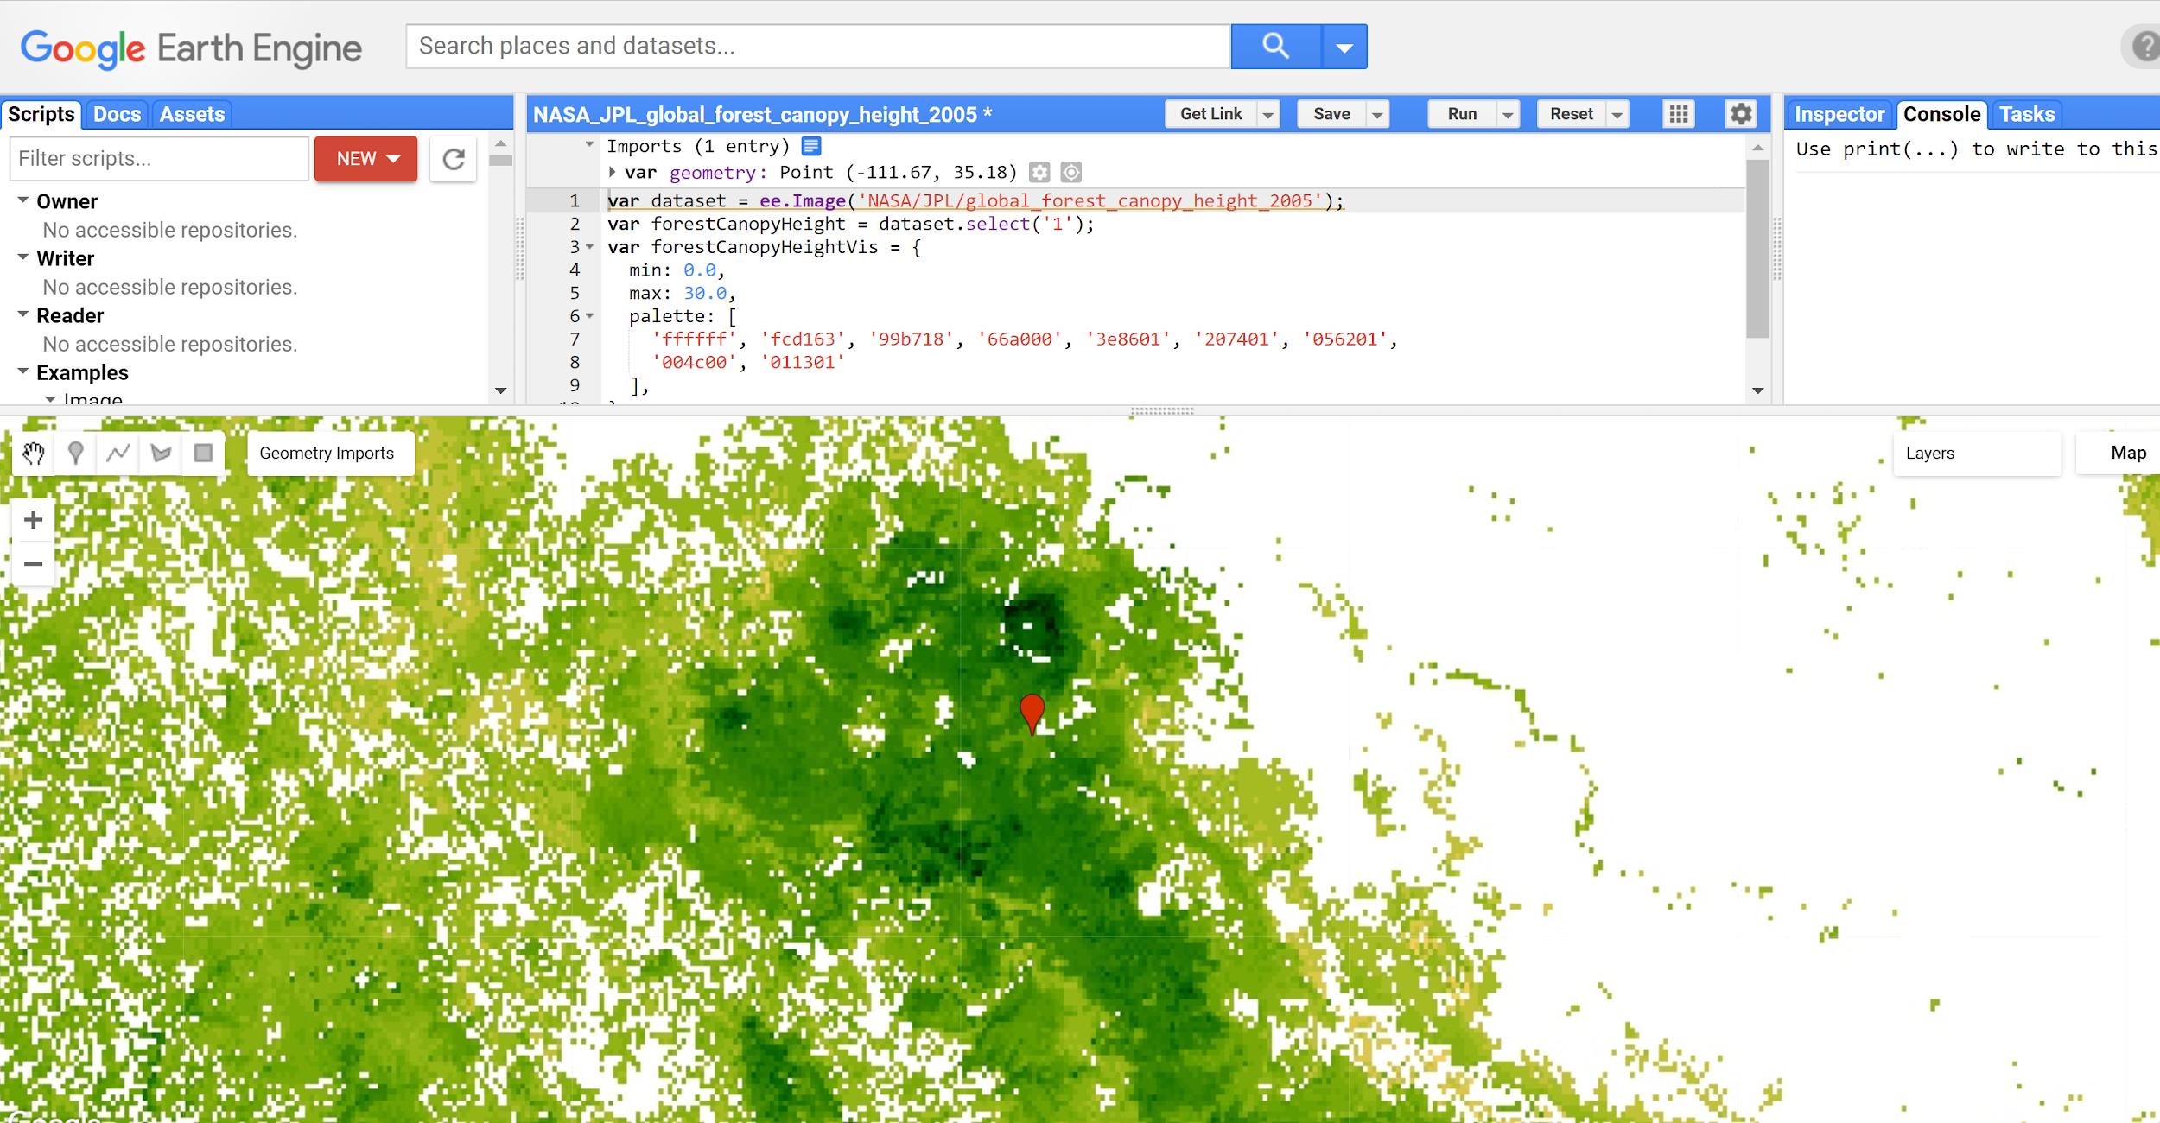
Get Information
Get Slide Data
Access location
Access google email
Access age range
Give this to the API
Access Google Earth Engine
  Pull time lapse
  Pull points
  Graph points
Access Ecolocation data
  Pull different animal traits based on a slide outline.

Slide 13
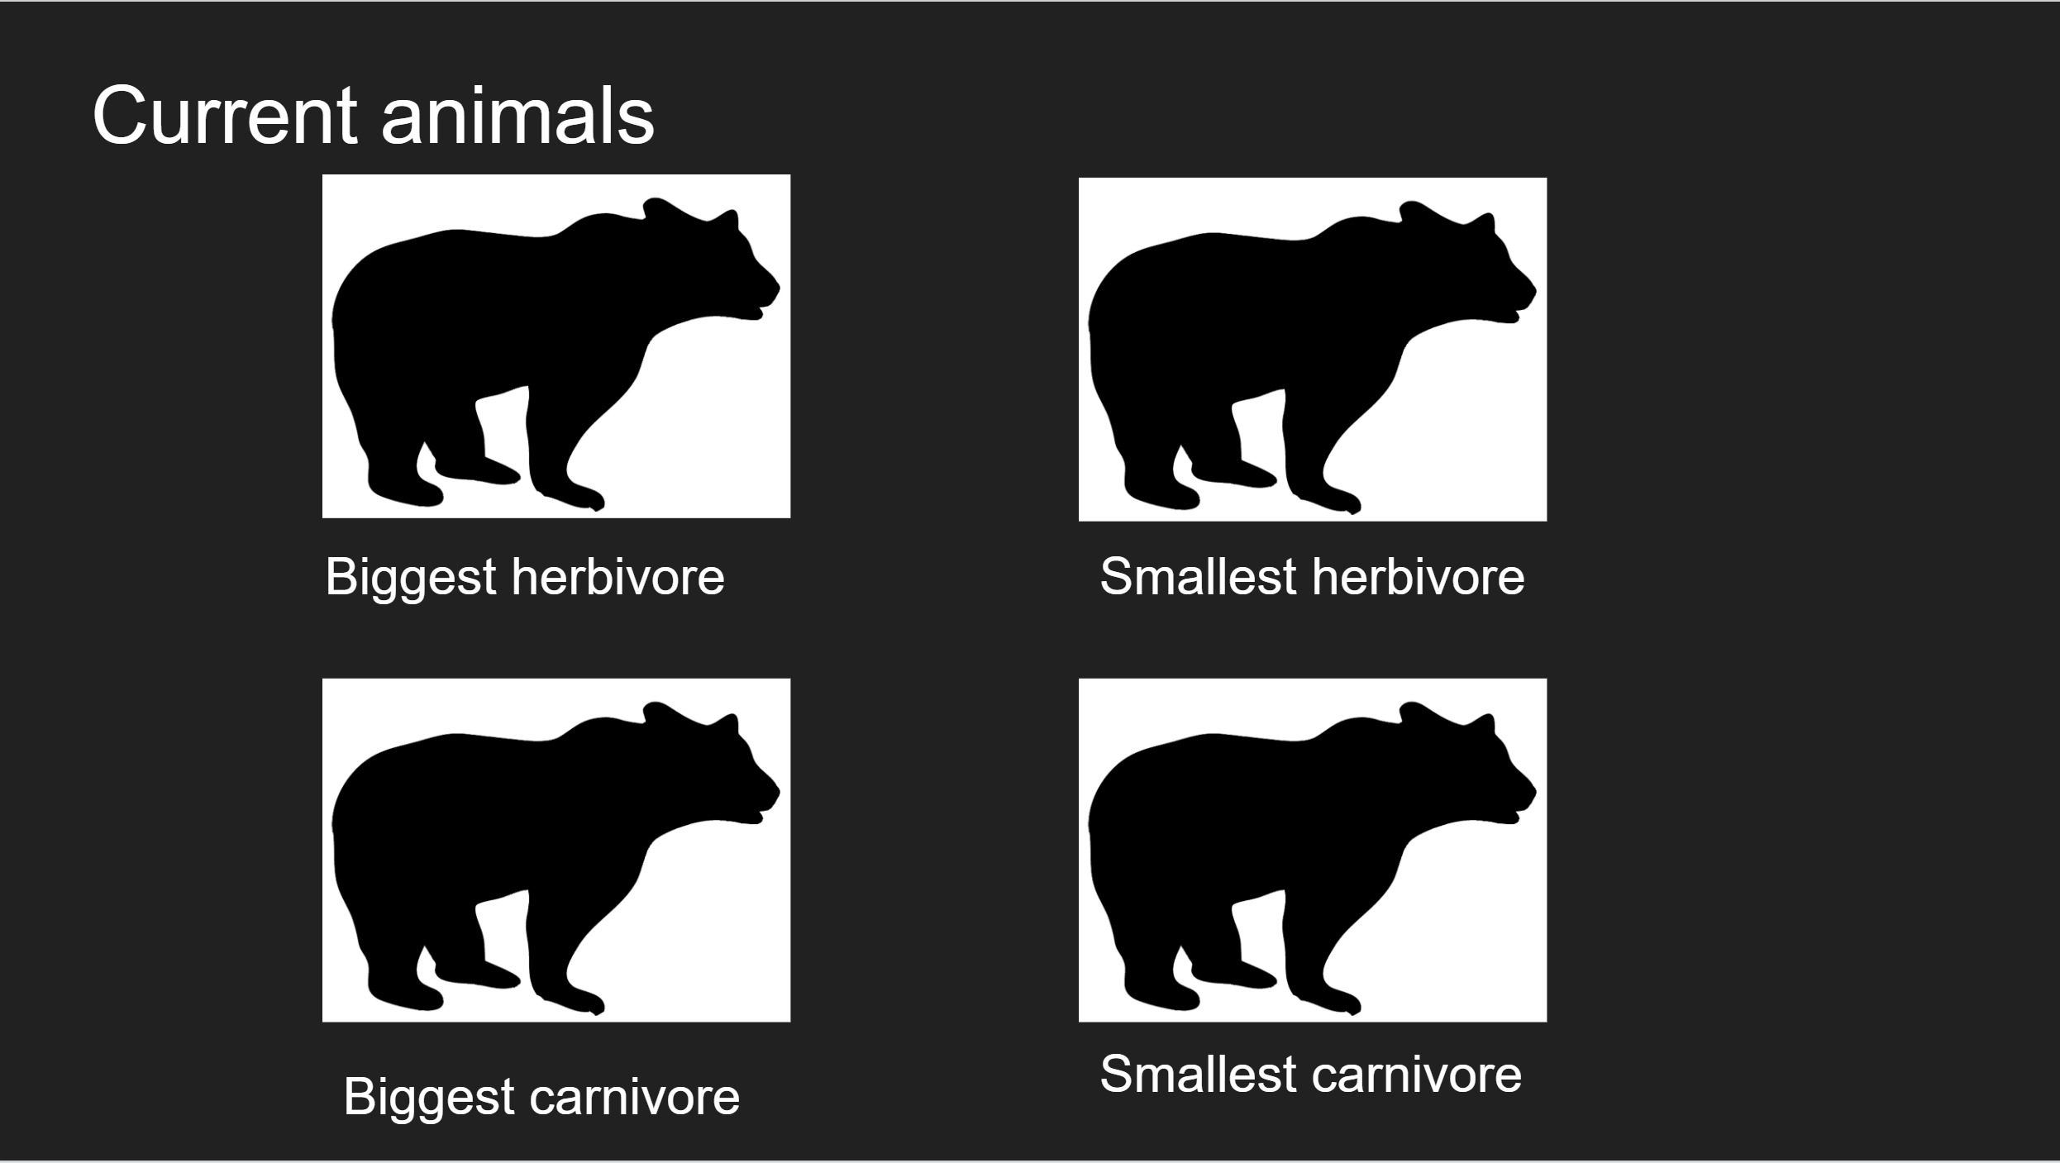
Create Slideshow
Distribute Slideshow
Fill a pre-made template with new information gathered by the APIs
  Hold templates from Doughty
  Sort templates by type
Access Google Drive

Slide 14
Risks and Feasibility
Risk | Likelihood | Severity | Response
Google Earth Engine become unavailable | Very Low | High | We will use a premium alternative to Google Earth Engine, ArcGIS
Amazon Web Servers become unavailable | Very Low | High | We will change our server to Oracle, which tested to be the 2nd best option
Unintuitive UI | Medium | Low | We will do more testing in classrooms
Climate Change political backlash | Low | High | Present the slides in a more politically neutral way
Notes:
J
Political backlash to it : low likelihood :
People aren’t crazy about climate change being taught in schools

Slide 15
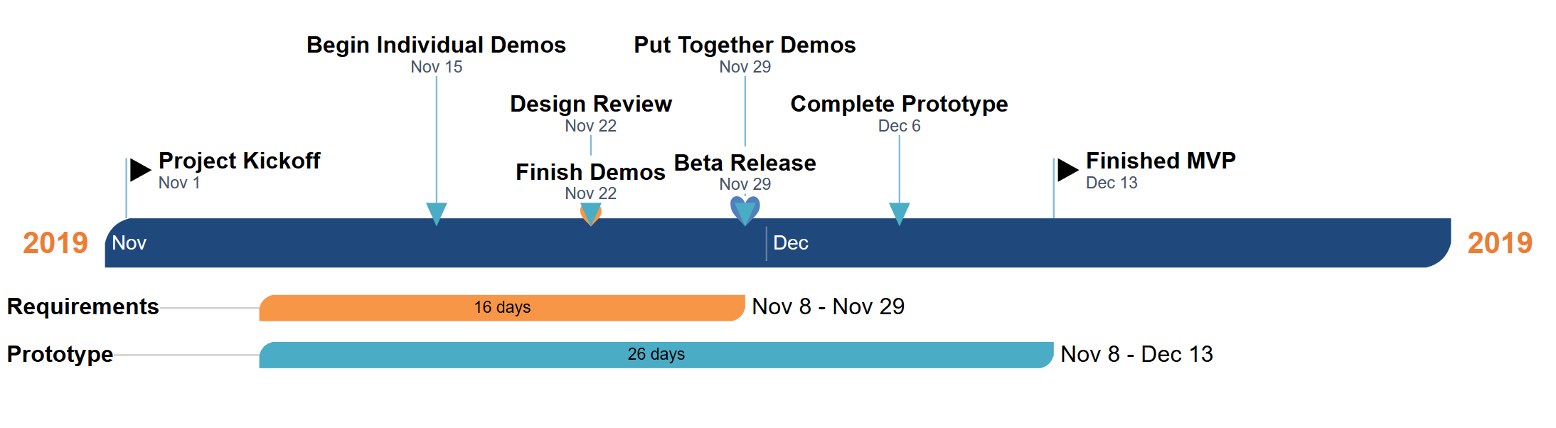
Design Phase Schedule
Sam - Google Earth Engine
Joshus - Ecolocation
Tyler - Slideshow template/creation
Kaitlyn - Website
Notes:
J
Vague even further into the future talk

Slide 16


Conclusion
Easily compile info for students and teachers
Information is based on location and topic
Straight-forward but open-ended requirements
We’re working on. . .
  Individual Components and combining them
Notes:
All the info is out there but teachers have no easy way to compile it so kids can learn about it.
Web Application which allows teachers to select a location, a topic, and a slide show pres will be automatically generated for them.
**Req Acq, Functional, Performance, Environmental Reqs, and Risks/Feas Info**
What is coming up for us
End with energy

